Slide 1
Unlock your Data Abilities
Key Takeaways to build successful AI and Data projects.

Slide 2

Hajar Khizou
- Artificial Intelligence and Data Consultant @Deloitte Luxembourg
- WiDS Luxembourg Lead
- VP of IEEE Young Professionals Morocco
+5 years of Volunteering for science and technology @ IEEE

Slide 3
Monitor your Data Quality
Set-up a Data Governance Program
Build a Robust Data Architecture
Be Decision Driven, more than Data Driven
01
02
03
TABLE OF CONTENTS
Build your MVP
Let your Data Speak!
Success = Team Sport
Diversity of perspective
04
05
06
07
08

Slide 4
Be Decision Driven, more than Data Driven
Decisions lead to action, but data informs action.

Slide 5
274.3 Bn USD
Estimated Global Data and Analytics Market by 2022

Slide 6
Corporate Data Literacy
93%
25%
21%
Global business leaders believe it is vital for their employees to be data literate.
Employees felt fully prepared to use data effectively when entering their current role.
Global workforce feel confident in their data literacy skills.

Slide 7
Decision-Driven Vs. Data-Driven
 | Decision-Driven | Data-Driven
Key Data | What’s missing | What’s available
Explores | The unknown | The known
Searches | Wide first | Deep first

Slide 8
Set-up a Data Governance Program
- Learn to drive your Ferrari.

Slide 9
Data as an Asset. Key Phases to Build your Data Agenda
Phase 1: Data governance assessment
Phase 3: Data governance strategy
Phase 2: Conduct a pilot
“Once they see the Ferrari, everybody wants a ride.”

Slide 10
Build a Robust Data Architecture
- Open doors to scalable AI.

Slide 11
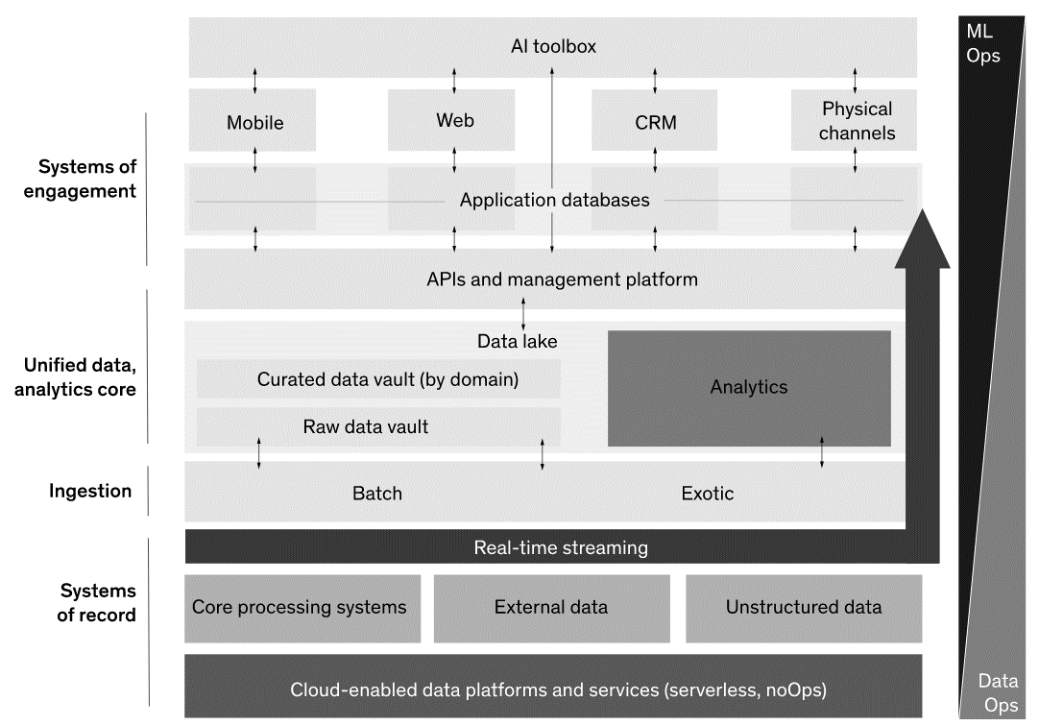
A Data Architecture that drives Innovation

Slide 12
Monitor your Data Quality
- Beyond Technical Data Quality.

Slide 13
Business Data Quality
Automation
Audit
Automate the decisions that business makes in its day-to-day operations.
Audit data produced by existing processes for compliance with external regulation as well as internal business policies and goals.

Slide 14
Let your Data Speak !
- And listen carefully.

Slide 15

The DEPTH
“A picture can be worth a thousand clicks.”

Slide 16
Build your MVP
- And scale.

Slide 17
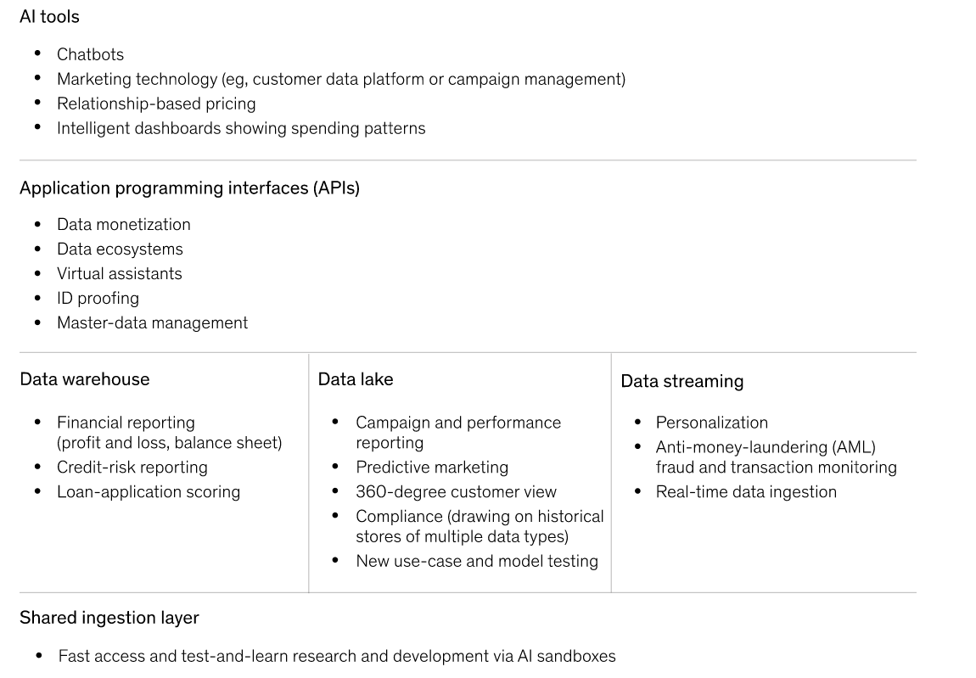
Achieve results faster!

Slide 18
Success = Team Sport
- Diverse backgrounds, no siloed teams.

Slide 19
A diverse team for the win!
Two thirds of organizations rely on a select group of employees who have been trained on analytics or data science, versus 27 percent who say that all employees are trained or the small minority that trains no employee.
In companies where executives report that all employees have been trained on analytics, 88 percent exceeded business goals, compared to just 61 percent of companies in which only select employees have been trained on analytics.

Slide 20
Diversity of perspective
Gender diversity also matters.

Slide 21
Why gender diversity matters?
Organizations with at least one diverse board member increased their average share price by 44 percent in their first year after going public, a significantly higher figure than companies with no diverse members (13 percent).
Since 2016, publicly traded large-, mid-, and small-cap companies in the United States, Canada, and Europe that prioritize gender diversity among their executive leadership and board of directors have yielded higher net returns in their respective equity markets than companies not committing to gender diversity.
Among Western European companies, a 10 percent increase in the ratio of women to men in the workforce correlated with a 7 percent increase in market value.

Slide 22
Resources
Deloitte AI Institute, Women in AI, https://www2.deloitte.com/us/en/pages/consulting/articles/state-of-women-in-ai-today.html
Deloitte, Analytics and AI-driven enterprises thrive in the Age of With, https://www2.deloitte.com/content/dam/Deloitte/ec/Documents/technology-media-telecommunications/DI_Becoming-an-Insight-Driven-organization%20(2).pdf
Deloitte, The Data Agenda empowers your most valuable asset, https://www2.deloitte.com/content/dam/Deloitte/ca/Documents/insights-and-issues/ca-en-insights-issues-the-data-agenda.pdf
Deloitte, Driving Business Value with AI in the Data Cloud, https://www2.deloitte.com/content/dam/Deloitte/us/Documents/about-deloitte/us-driving-business-value-with-ai-in-the-data-cloud.pdf
TechnoSapien, Be Decision-Driven Not Data-Driven, https://techno-sapien.com/blog/decision-driven
Mckinsey, Breaking through data-architecture gridlock to scale AI, Building a data architecture to scale AI | McKinsey

Slide 23
THANKS
Do you have any questions?
hajarkhizou@ieee.org
linkedin.com/in/hajarkhizou
Hajar.tech

